Slide 1
DATA SCIENCE PROJECT House Location Recommendation using AURIN Data

Slide 2
Progress Workflow
1
Collect Early Features From AURIN
8
Cluster Analysis on Categorial Features
2
Build A Prototype
9
Interpret Cluster Analysis Results
3
10
Harvest Tweets in Australia Bounding Box,
convert the coordinate to SA2 Areas
Collect All SA2 datasets From AURIN
4
Select Final Features Based on Correlation
and Justification on Business Case
11
Association Rule Mining on State and SA2 Areas
Based on Tweet Location per Twitter Users
5
Handle Missing Values
12
Sentiment Analysis Demographic Classification
Using Prelabelled Training Set
on
progress
6
Compare Different Clustering Algorithms
on Different Setting
13
Topic Modelling on Tweets
7
Rescale Data into Categorial Features
14
Build A Web Application for User Inputs and Map Visualization

Slide 3
Analysis on

Slide 4
Build a Prototype
Goal | - | Get preliminary analysis on how users may choose their preferences and how the output look like
 | - | Analyze the relative difference between inputs
Method | - | Features selected based on user choices
 | - | If a feature is chosen, user set the priority to high or low and data is ranked according to the sorted order. If a feature is set to not priority, it will be ignored.
 | - | Aggregate all the ranking by average and return the output according to descending order of the average
Findings | - | A change in a feature order or priority have different impact on the output, some features may significantly change the output, some may not.
 | - | There are some cities that are robust to some changes
Problems | - | Showing a list of cities does not describe the spatial correlation between cities
 | - | There is no option for moderate value. Some users may want to set a feature as priority but not necessarily put an order
 | - | No clear boundary of city profile related to all features
Recommendation | - | Build a web application with adjustable options to show a heat map
 | - | Find more features and aggregate them to construct the city profile
 | - | Do clustering based on city profile that can cover all combinations of user input on feature selection and feature values such as low, moderate, high

Slide 5
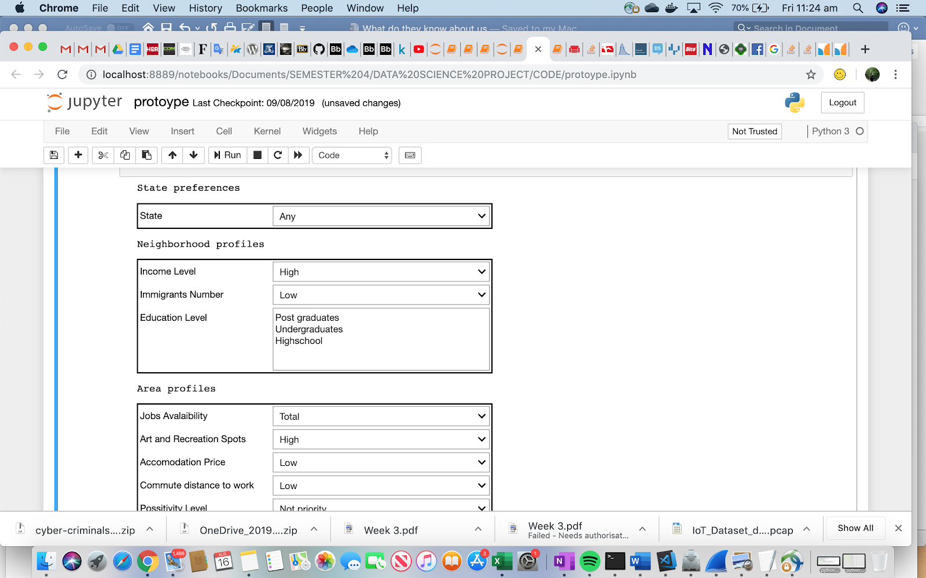
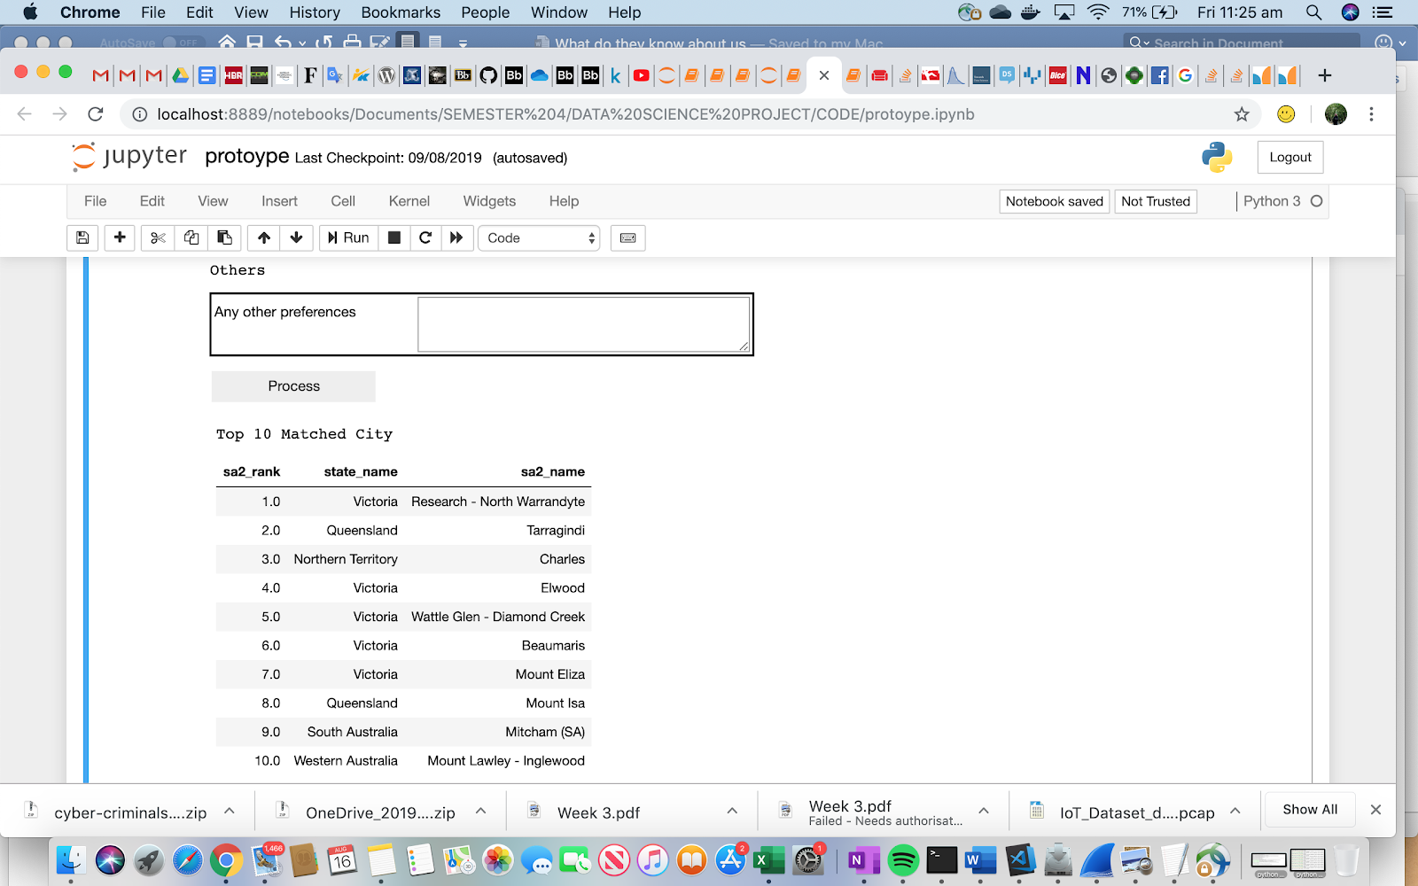
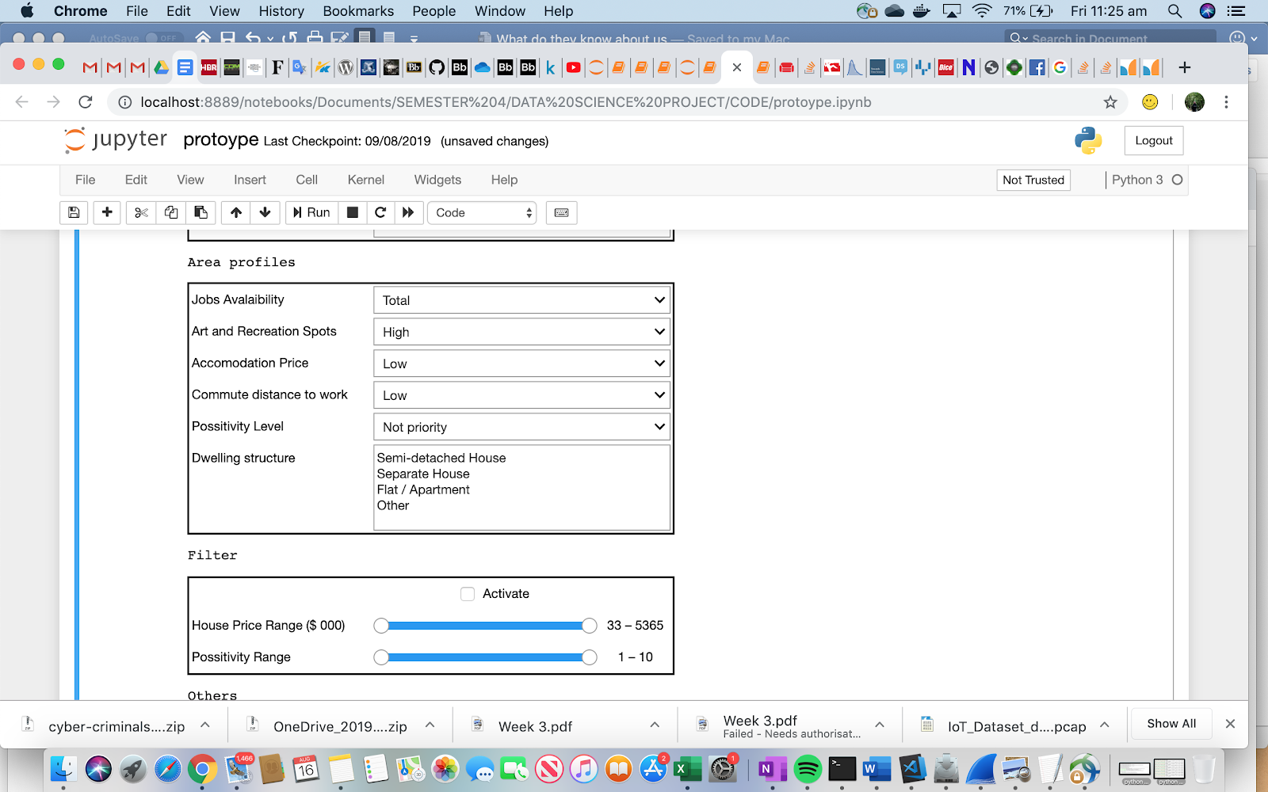
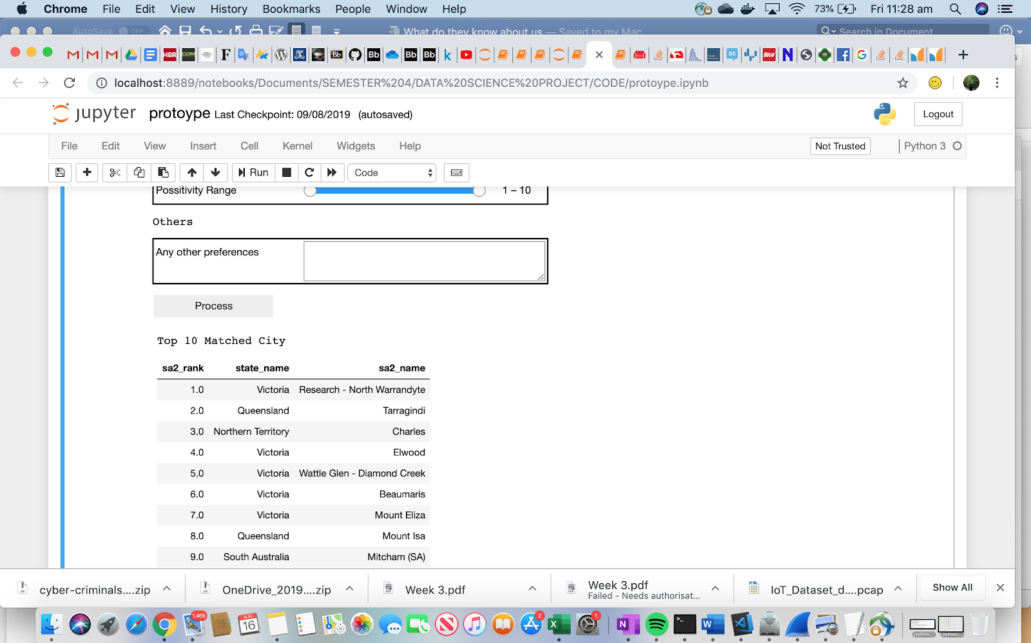
Prototype Interface on Jupyter Notebook
Default Setting
Income : High
Migration : Low
Education : Not Priority
Number of Jobs : High
Recreation sports : High
Accommodation price : Low
Commute distance : Low
Dwelling structure : Not Priority
House price : Not Priority

Slide 6
Relative Impact on User Input
Default
setting
Set Recreation Spots
as Not Priority..[1]
[1] and house price < 3011000
Set Income as Low,
Migration as High..[2]
[2] and house price < 3011000
Rank | state_name | sa2_name | state_name | sa2_name | state_name | sa2_name | state_name | sa2_name | state_name | sa2_name
1 | Victoria | Research - North Warrandyte | Queensland | Mount Isa | Queensland | Mount Isa | Queensland | Cairns City | Queensland | Cairns City
2 | Queensland | Tarragindi | Western Australia | Mullaloo - Kallaroo | Western Australia | Mullaloo - Kallaroo | Victoria | Grovedale | Victoria | Grovedale
3 | Northern Territory | Charles | Victoria | Research - North Warrandyte | Victoria | Research - North Warrandyte | Victoria | Reservoir - East | Victoria | Reservoir - East
4 | Victoria | Elwood | Queensland | Tarragindi | Queensland | Tarragindi | Victoria | Ballarat - South | Victoria | Ballarat - South
5 | Victoria | Wattle Glen - Diamond Creek | Queensland | Chelmer - Graceville | Queensland | Chelmer - Graceville | Victoria | Ballarat - North | Victoria | Ballarat - North
6 | Victoria | Beaumaris | Victoria | Wattle Glen - Diamond Creek | Victoria | Wattle Glen - Diamond Creek | South Australia | Paradise - Newton | South Australia | Paradise - Newton
7 | Victoria | Mount Eliza | Queensland | Eimeo - Rural View | Queensland | Eimeo - Rural View | New South Wales | Port Macquarie - East | New South Wales | Port Macquarie - East
8 | Queensland | Mount Isa | Northern Territory | Charles | Northern Territory | Charles | New South Wales | Sawtell - Boambee | New South Wales | Sawtell - Boambee
9 | South Australia | Mitcham (SA) | Western Australia | Woodvale | Western Australia | Woodvale | New South Wales | Merrylands - Holroyd | New South Wales | Merrylands - Holroyd
10 | Western Australia | Mount Lawley - Inglewood | Queensland | Whitfield - Edge Hi | Queensland | Whitfield - Edge Hill | New South Wales | Umina - Booker Bay - Patonga | New South Wales | Umina - Booker Bay - Patonga

Slide 7
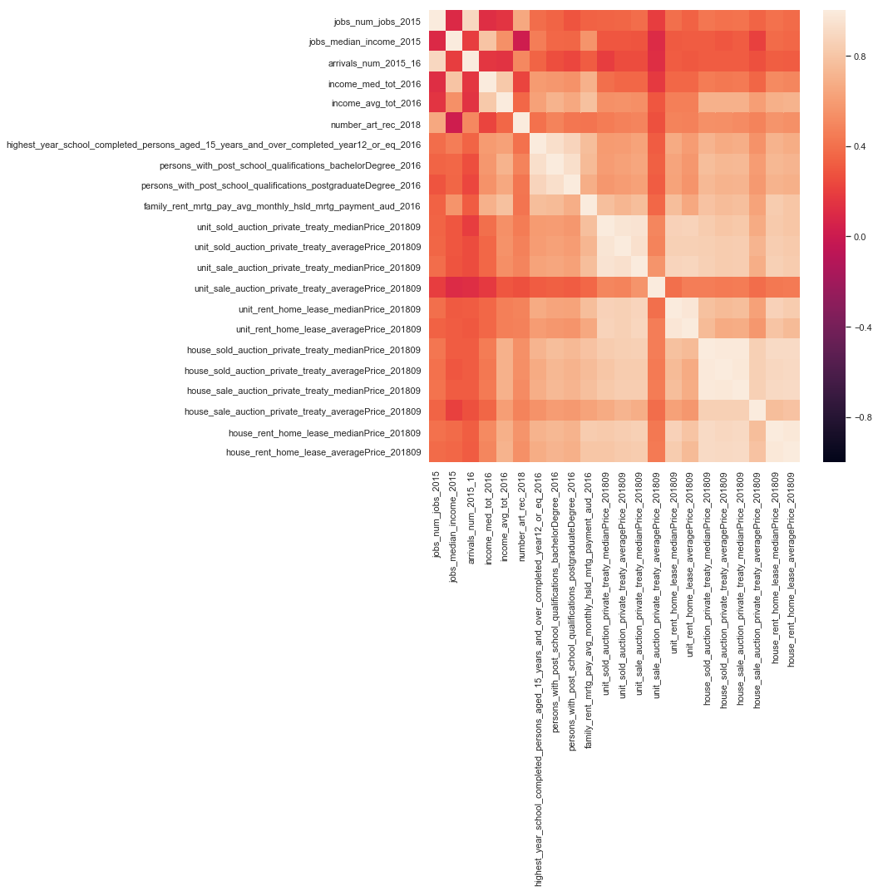
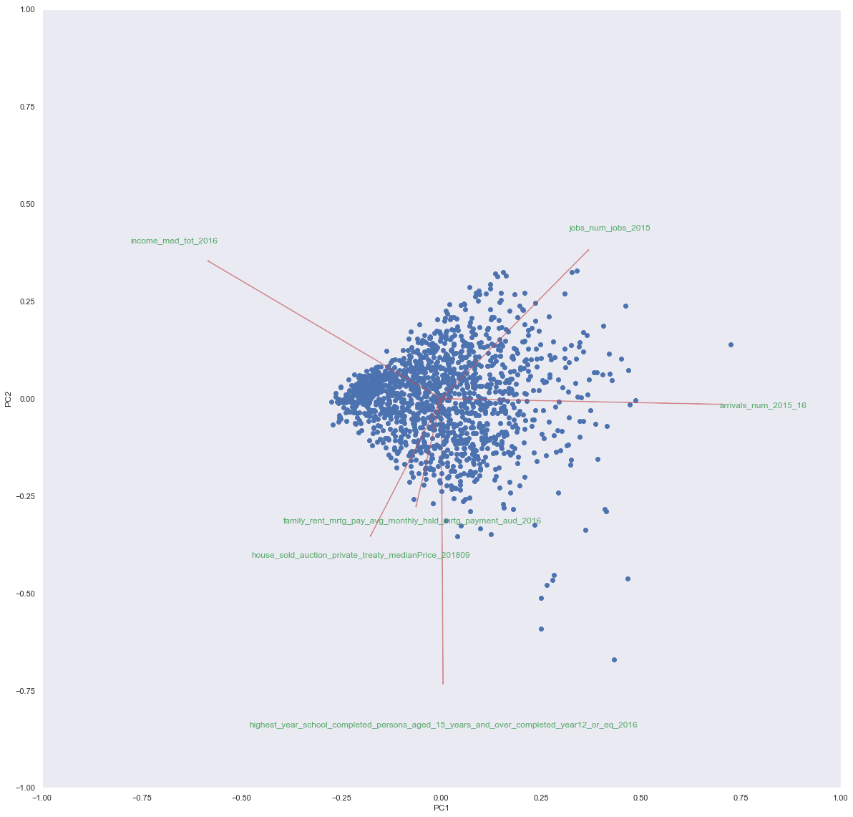
Early Features Correlation – Define Top 5: Income, Education, House Price, Unit Price, Rent Price

Slide 8
Extended Features From All Datasets in AURIN With SA2 Level – Correlation with the Top 5 Early Features

Slide 9
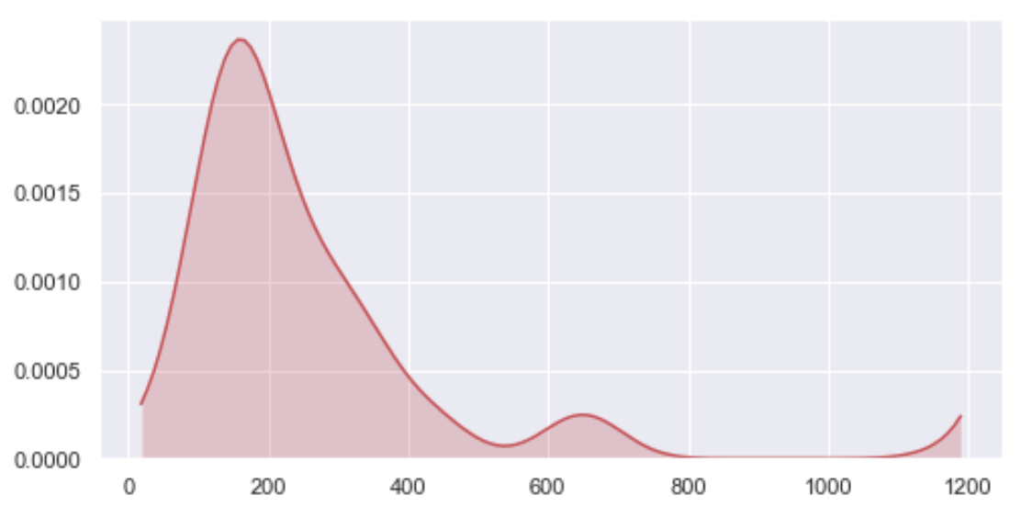
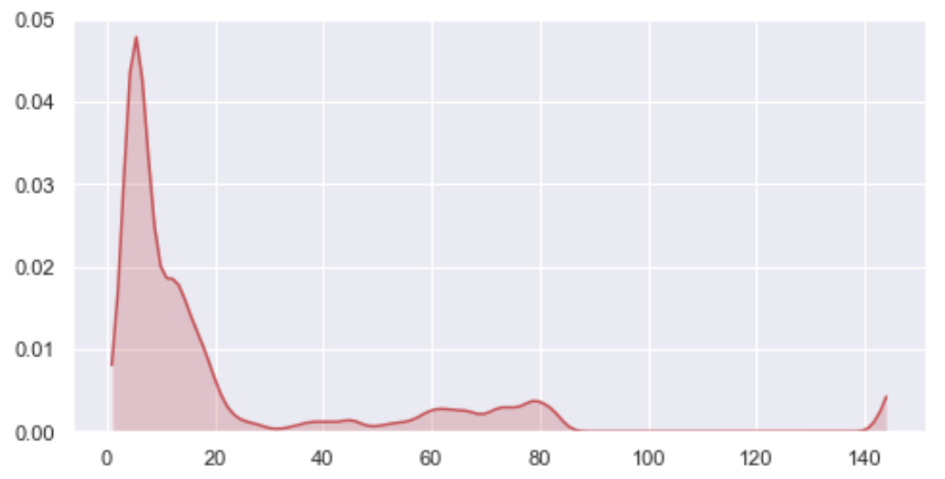
Problem - Missing Values
From 144 features
Distribution of Missing Values
Based on Features
Based on Areas
If delete missing values
By Areas → leave 636 areas
By features → leave 0 feature

Slide 10
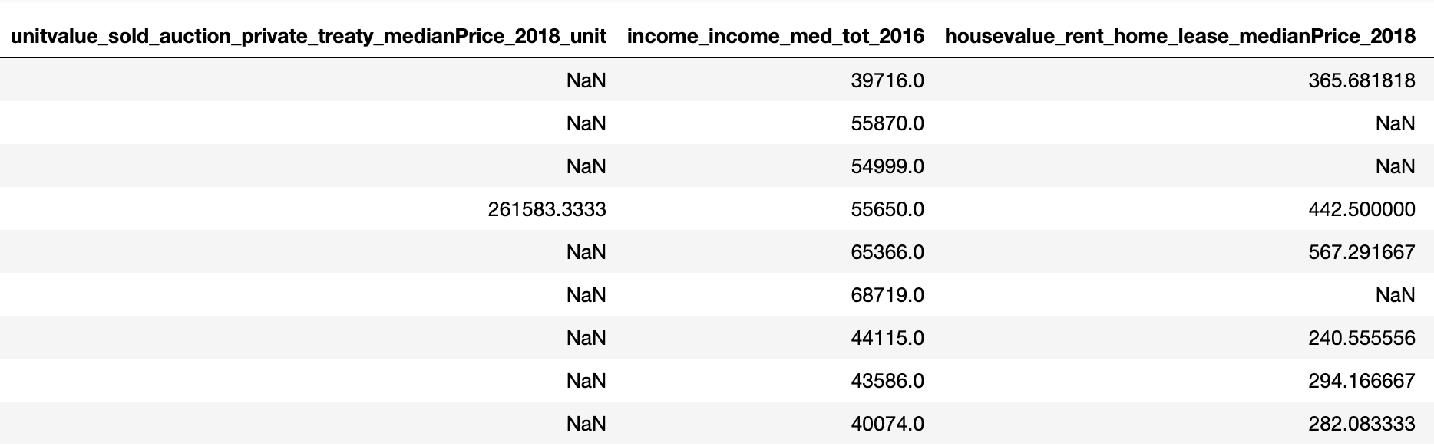
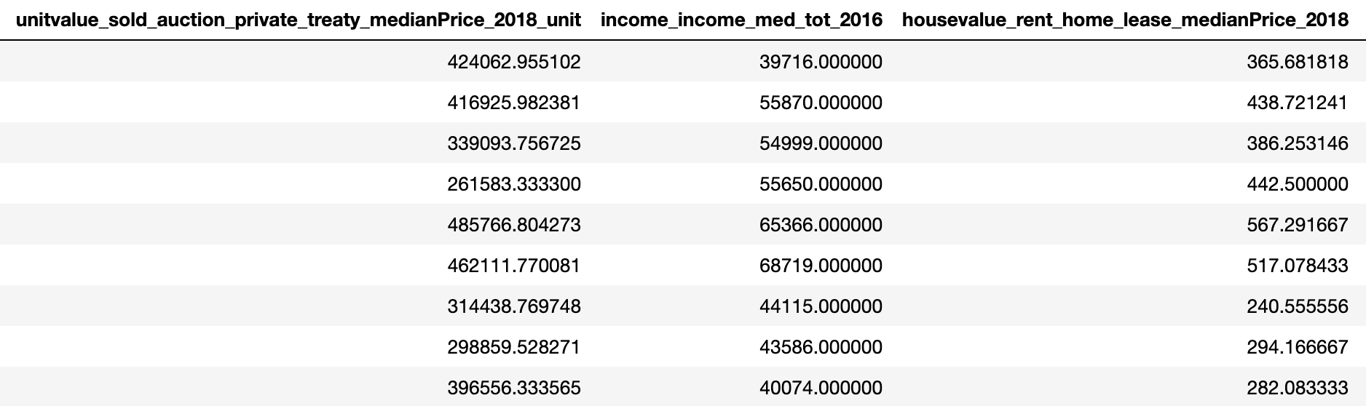
Handle Missing Value with Imputation Using Multivariate Imputation by Chained Equation (MICE)
Before
After

Slide 11
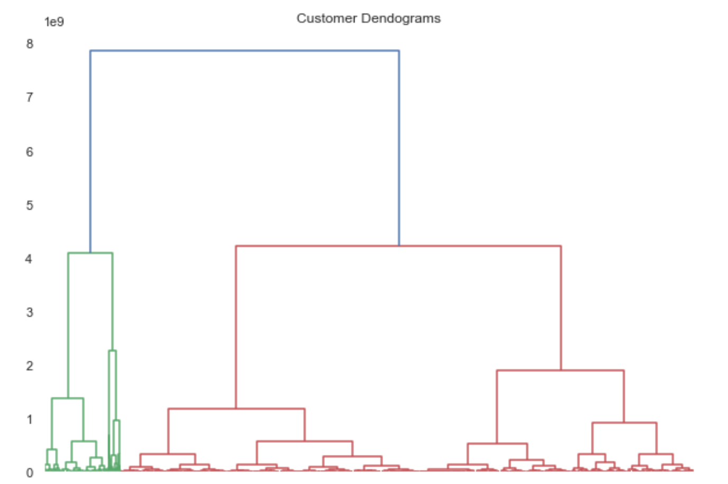
Determining Number of Clusters
10 clusters
20 clusters

Slide 12
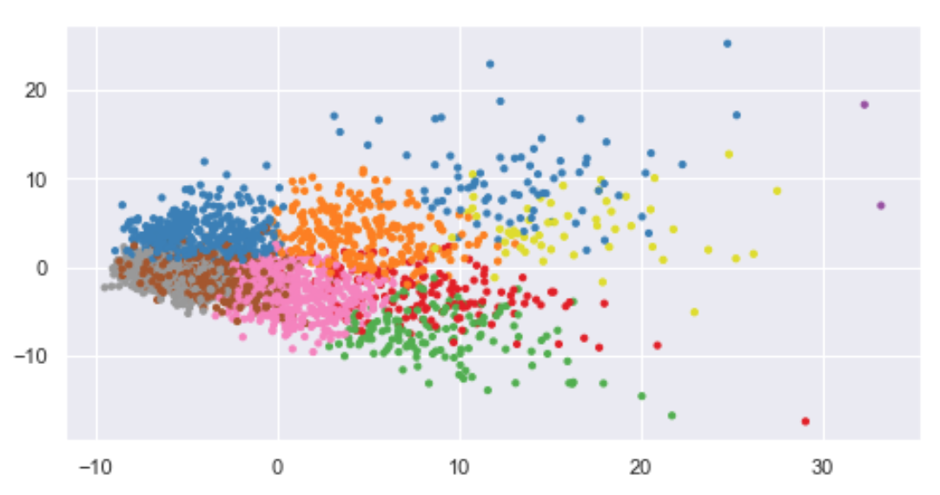
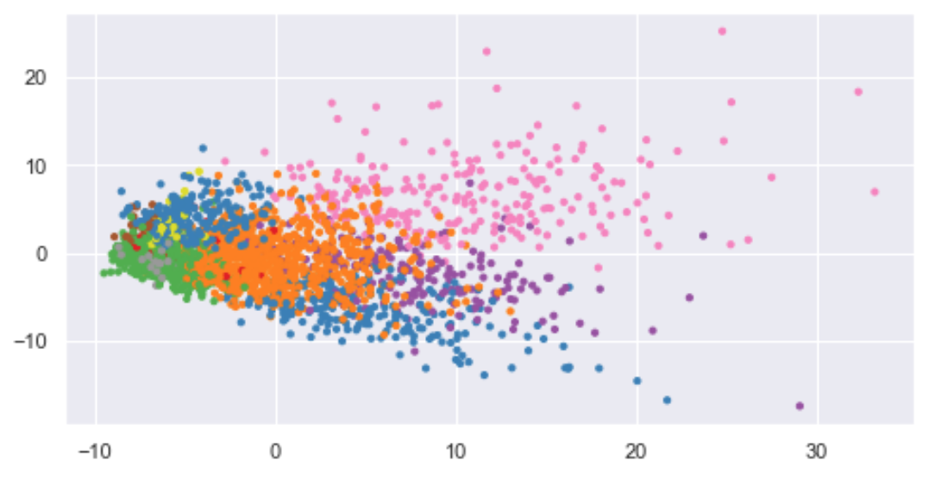
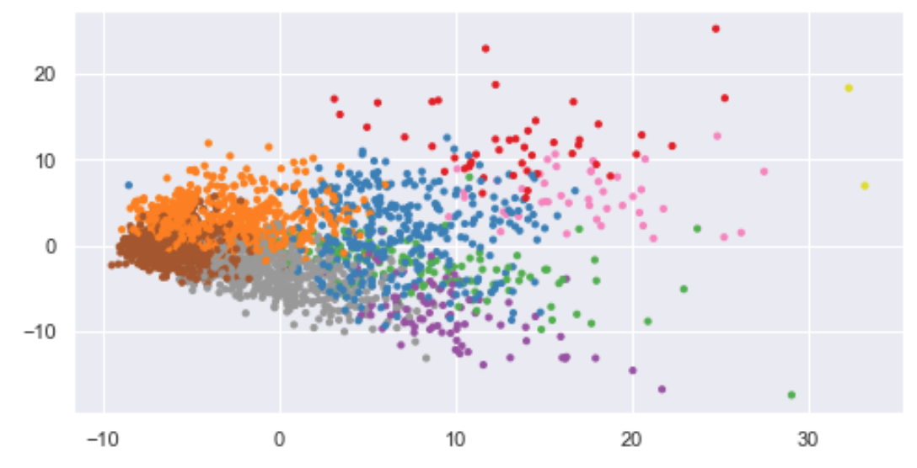
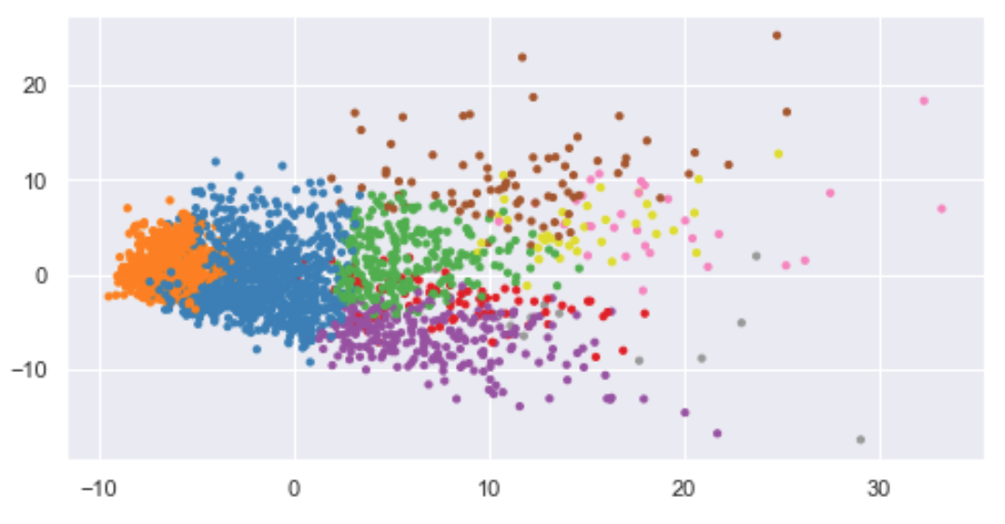
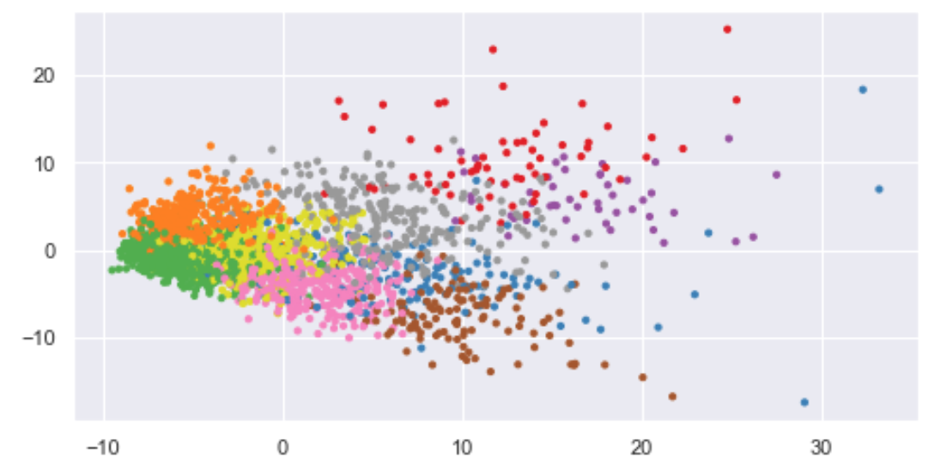
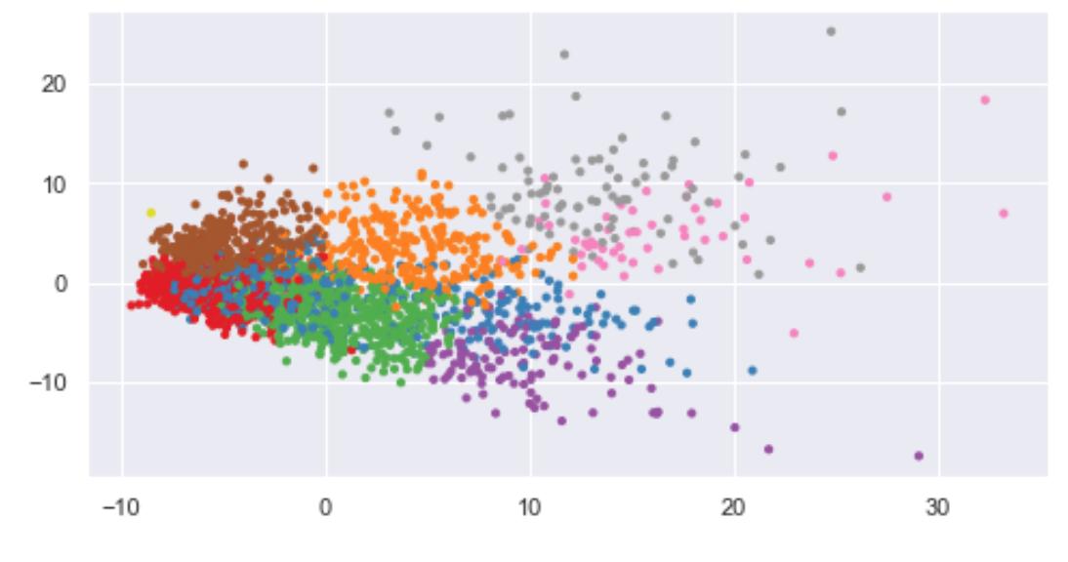
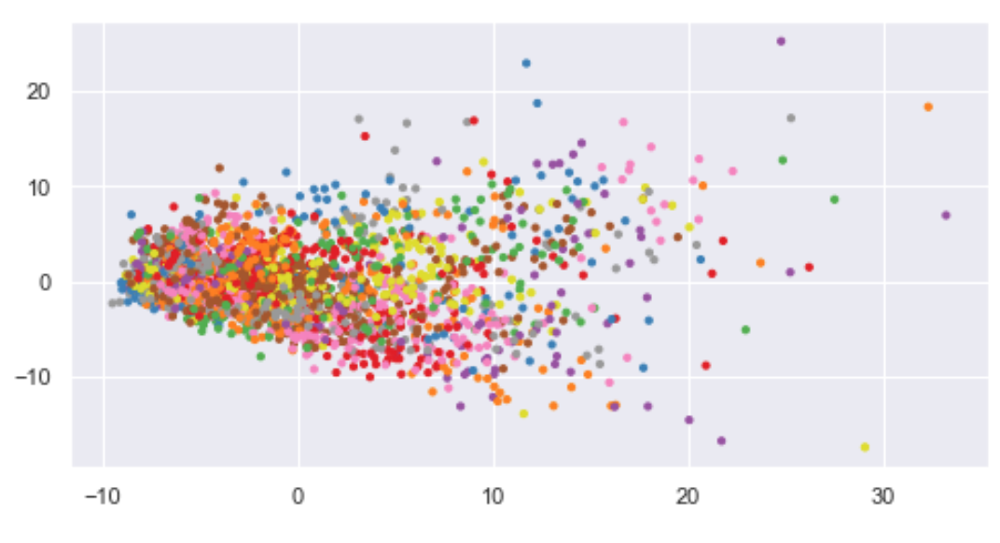
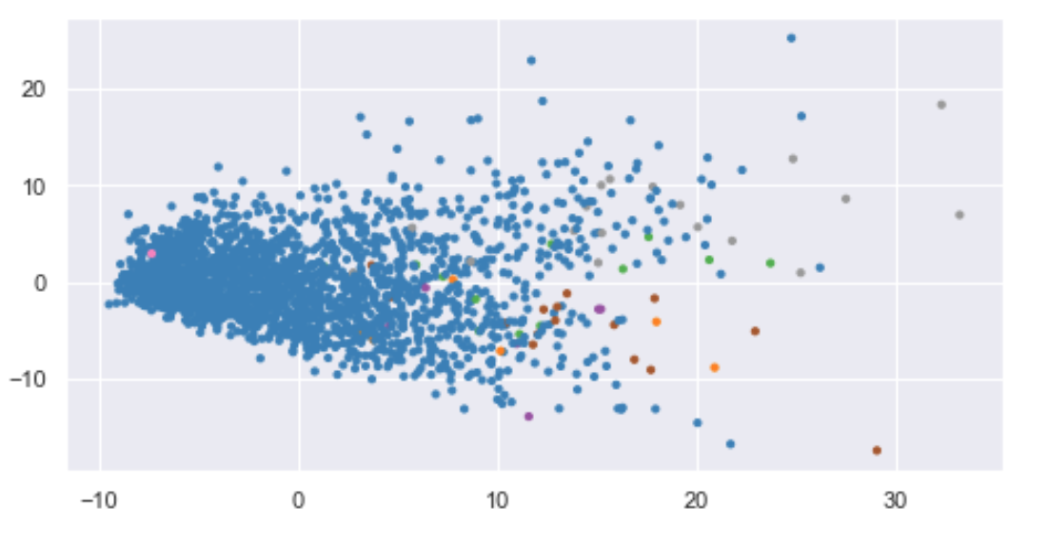
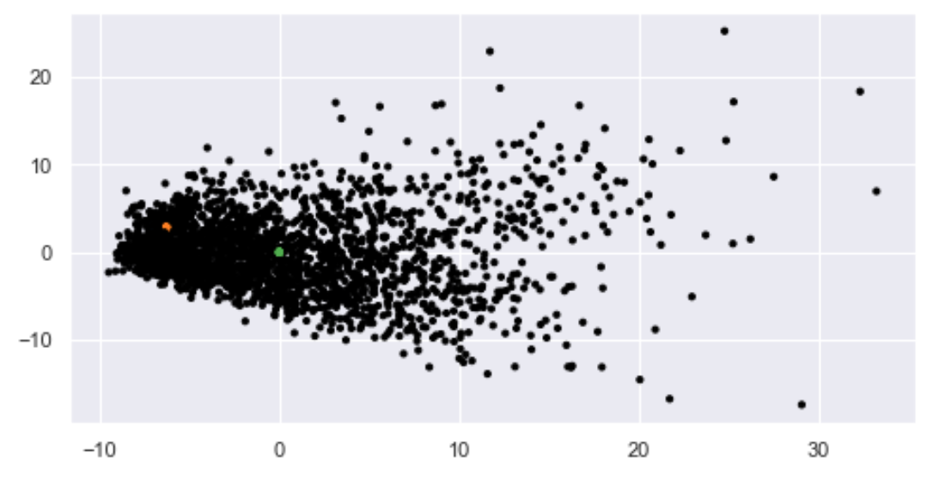
Compare Different Clustering Algorithms with Mostly 10 Clusters on PCA 1 & 2 Scatter Plots
K-Means
n cluster = 10
Spectral Clustering
n cluster = 10, eigen_solver='arpack'
Birch
n cluster = 10
Mini Batch KMeans,
n cluster = 10
Ward
n cluster = 10, linkage='ward'
Gaussian Mixture n cluster = 10, covariance type = full
Affinity Propagation
damping=0.9, preference=-200
MeanShift
Bandwidth = quantile 0.3
DBSCAN
Epsilon = 0.3

Slide 13
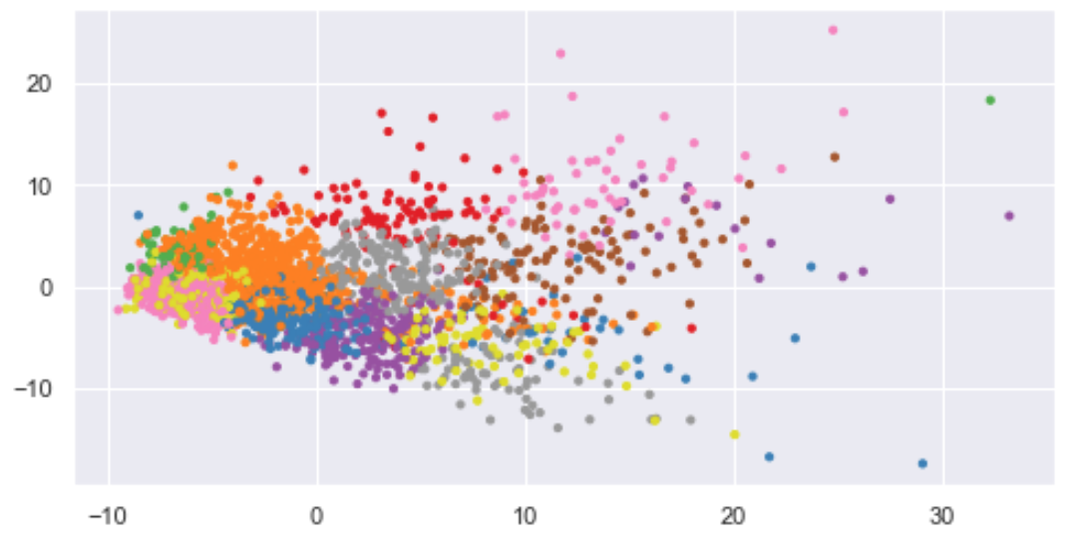
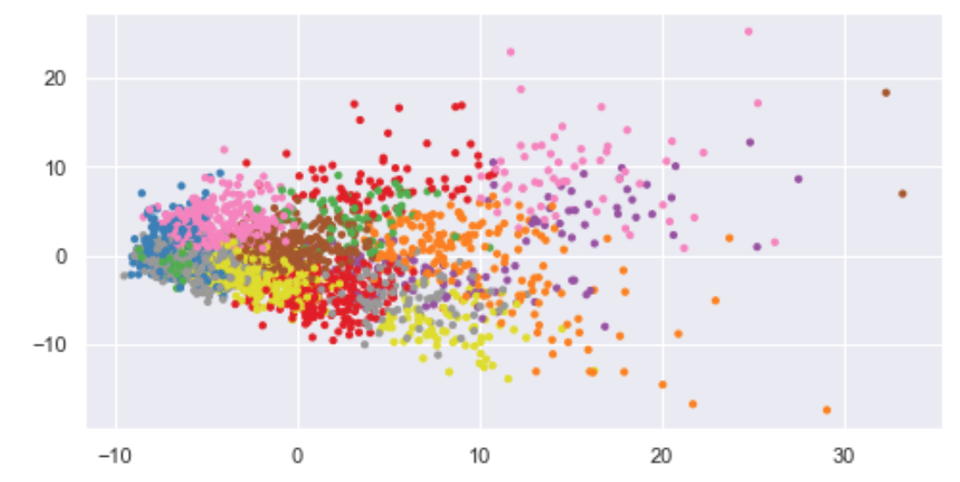
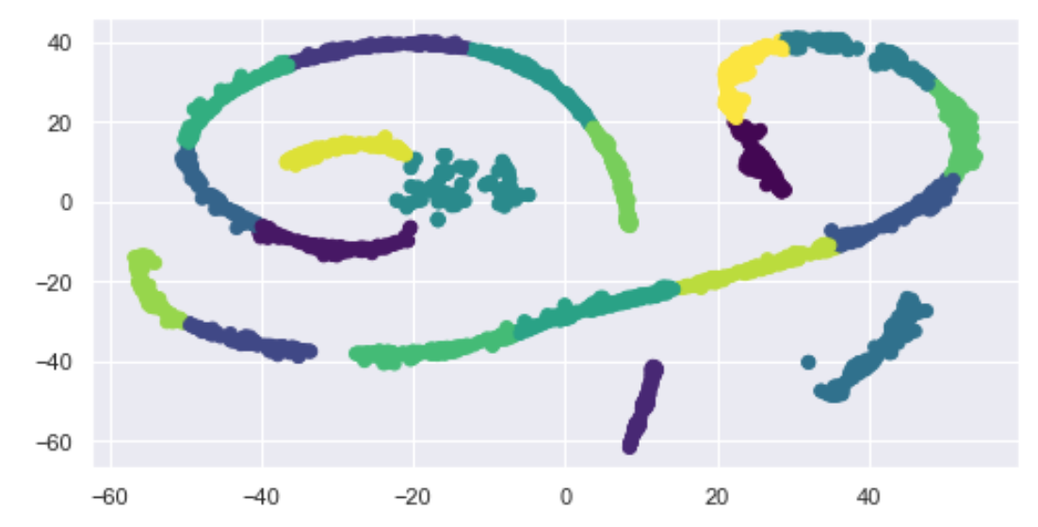
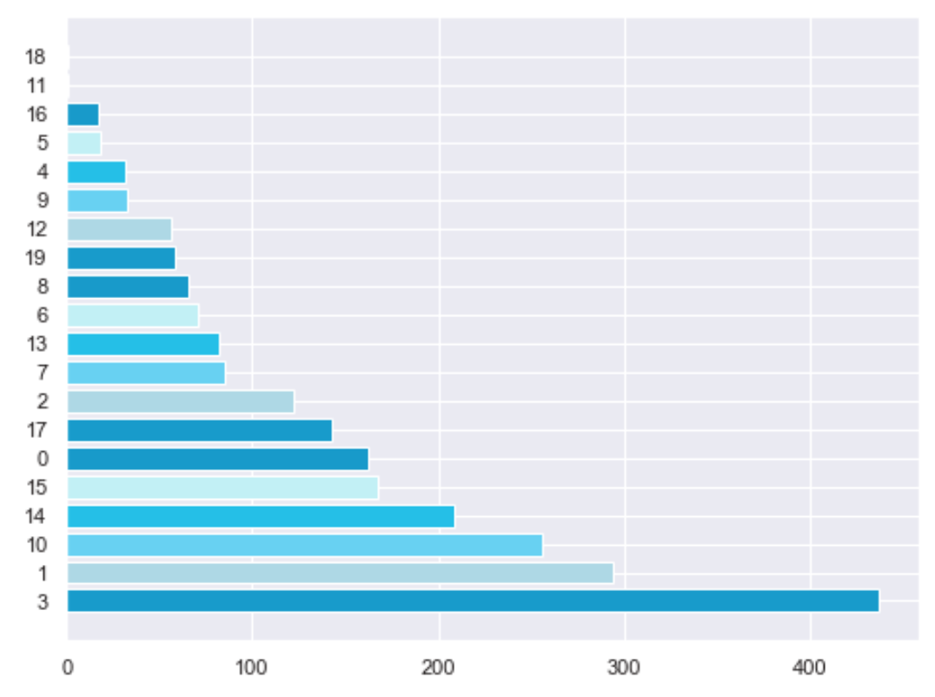
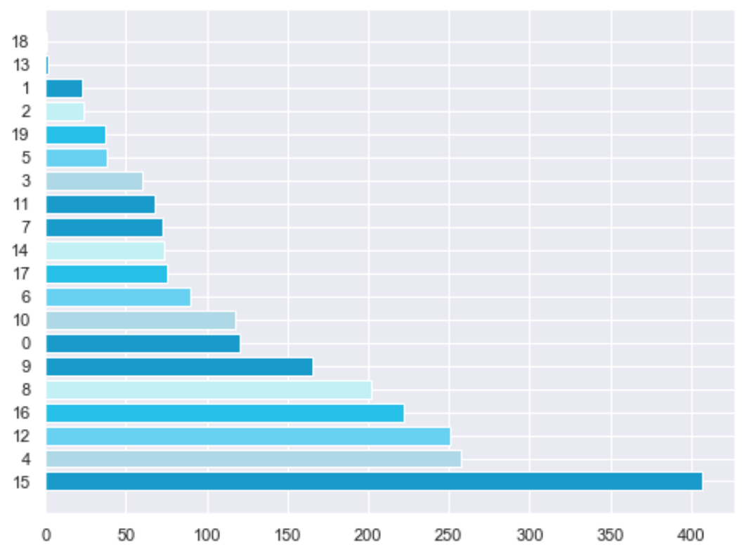
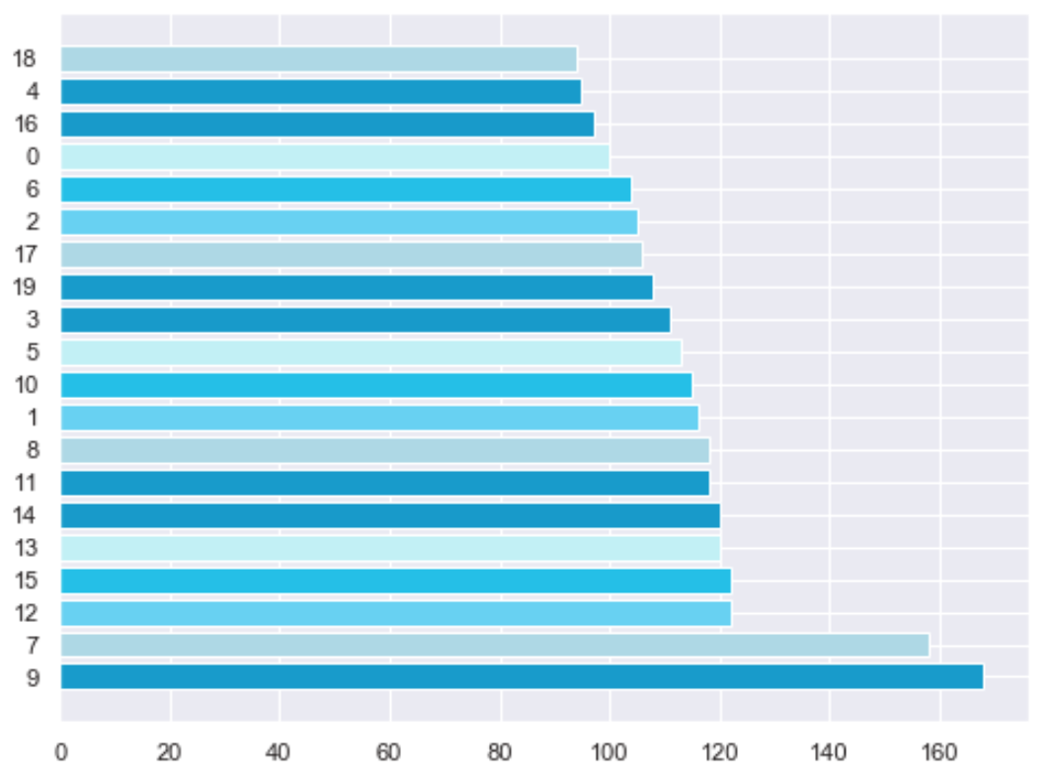
Compare K-Means Algorithm with 20 Clusters on Different Feature Representation
Standard Scale Actual Features
PCA
TSNE
18: Australian Capital Territory – Taylor
11: New South Wales - Sydney - Haymarket - The Rocks
18: Australian Capital Territory – Taylor
13: New South Wales - Sydney - Haymarket - The Rocks
Victoria - Melbourne

Slide 14
Compare Results on Small Cluster Size
K-Means Scaled Features 10 clusters
Mean Shift 10 clusters
DBSCAN epsilon 0.3
1 : New South Wales - Sydney - Haymarket - The Rocks
2 : Victoria - Melbourne
1 : Australian Capital Territory – Moncrieff
2 : New South Wales - Liverpool
Victoria - Corio - Norlane
Victoria - North Geelong - Bell Park
Victoria - Keilor East
Victoria - St Albans - North
Victoria - Taylors Lakes
3 : New South Wales - Auburn - Central
New South Wales - Merrylands – Holroyd
Victoria - Campbellfield – Coolaroo
Victoria - Meadow Heights
Victoria - Roxburgh Park – Somerton
Victoria - Dandenong
1 : New South Wales - Wollangambe - Wollemi
New South Wales - Centennial Park
Victoria - West Melbourne
South Australia - Happy Valley Reservoir
South Australia - Whyalla - North
Western Australia - Trafalgar (WA)
K-Means Scaled Features 20 clusters
1 : Australian Capital Territory – Taylor
2 : New South Wales - Sydney - Haymarket - The Rocks
K-Means PCA Features 20 clusters
1 : Australian Capital Territory – Taylor
2 : New South Wales - Sydney - Haymarket - The Rocks
Victoria - Melbourne
Gaussian Mixture 10 clusters
1 : Australian Capital Territory – Taylor
Findings
Birch 10 clusters
1 : Australian Capital Territory – Taylor
2 : New South Wales - Sydney - Haymarket - The Rocks
Victoria - Melbourne
SA2 Areas:
Sydney - Haymarket - The Rocks
Melbourne
Taylor
Tend to be classified independently according to different cluster algorithms.
These areas is suspected to have unique characteristics compared to the others.
Ward 10 clusters
9 : Australian Capital Territory – Taylor
New South Wales - Sydney - Haymarket - The Rocks

Slide 15
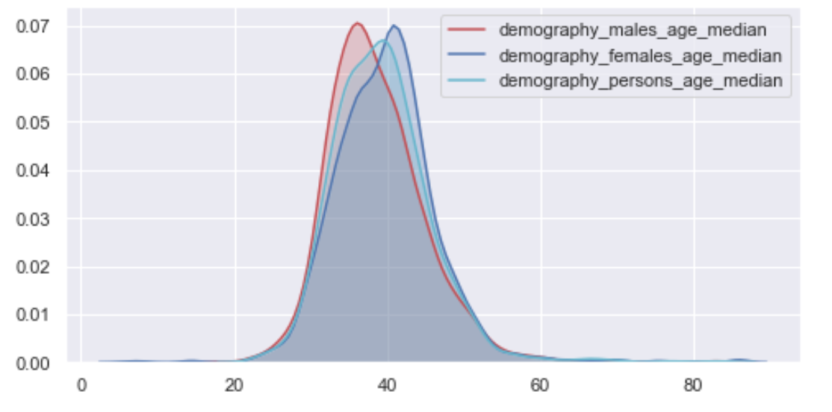
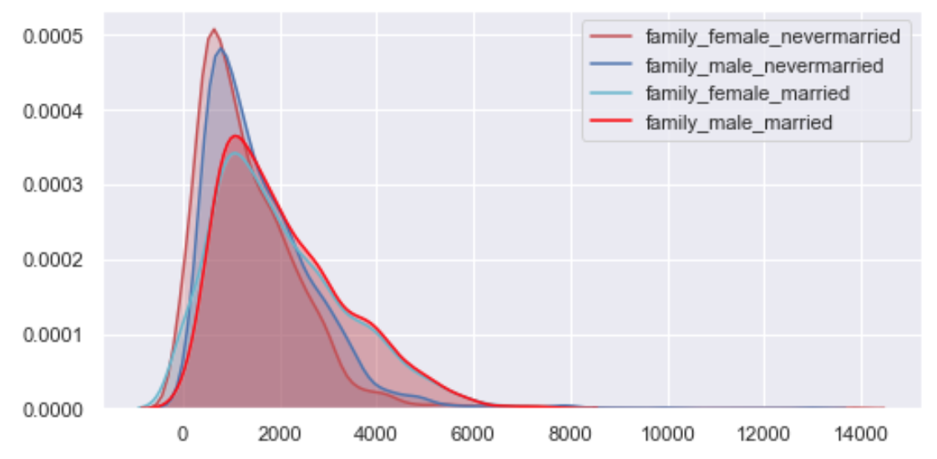
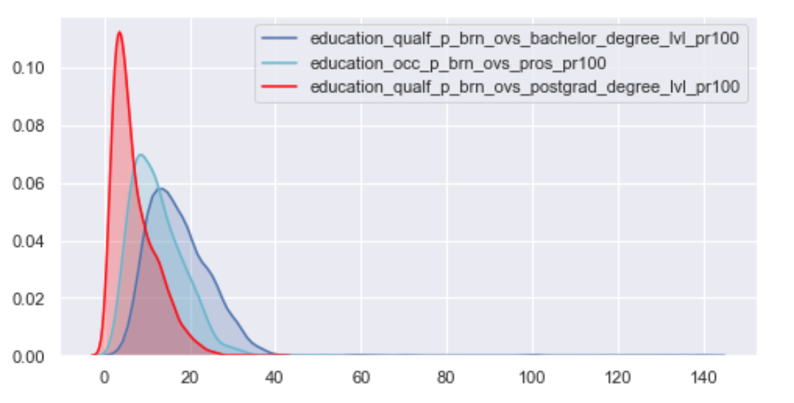
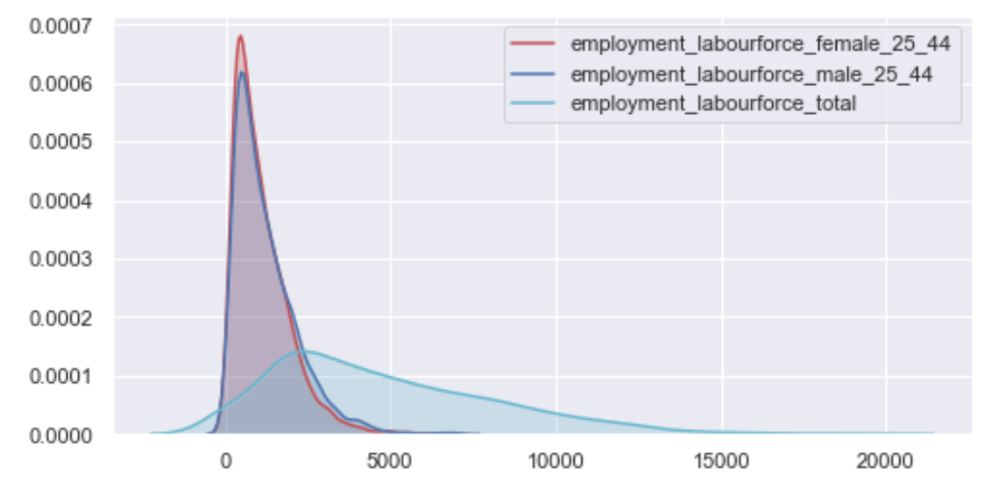
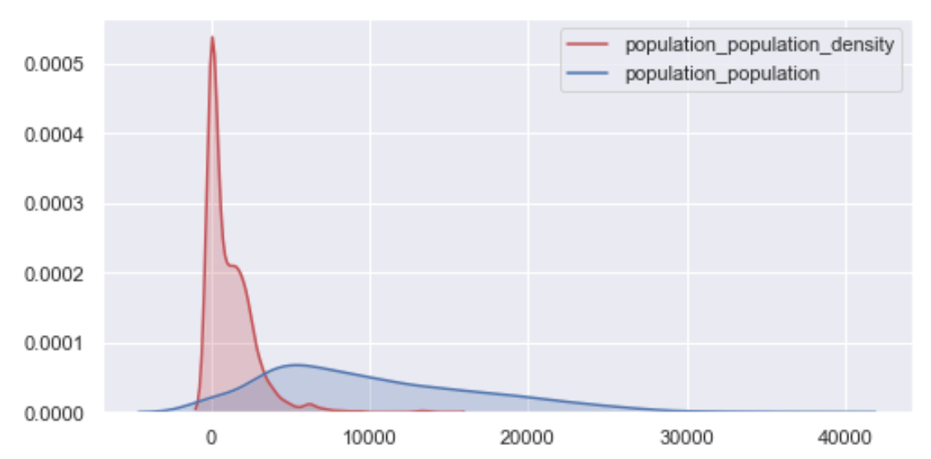
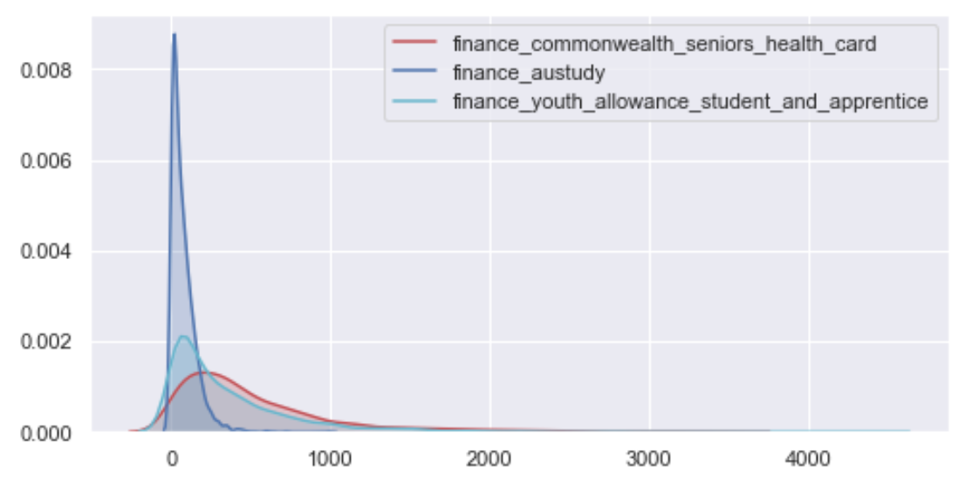
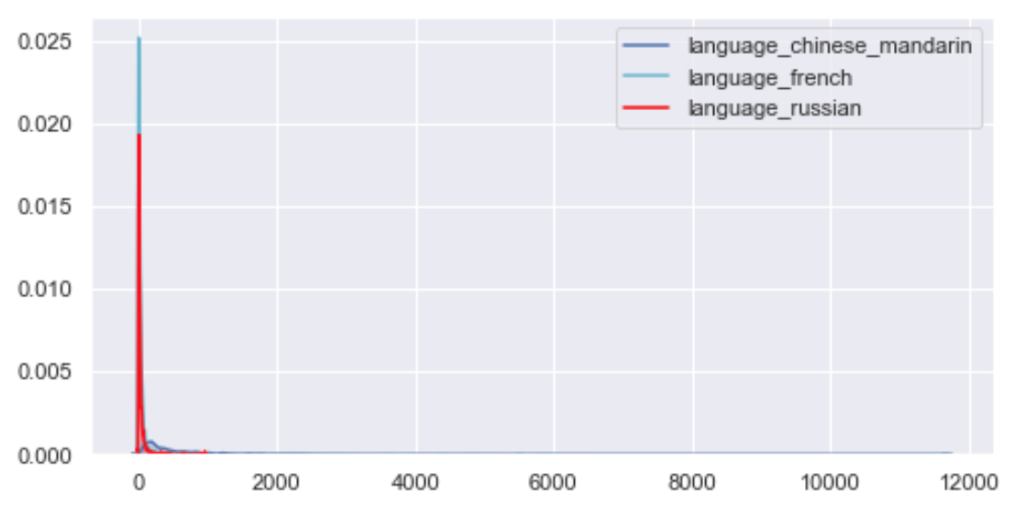
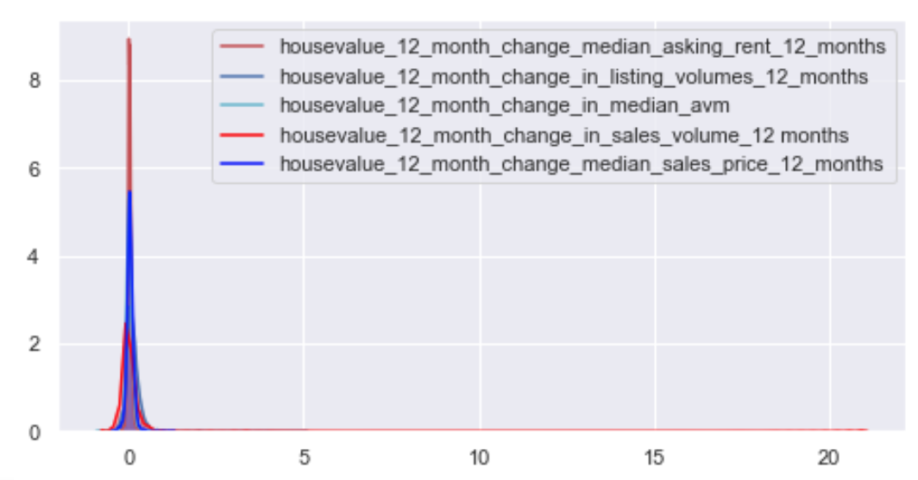
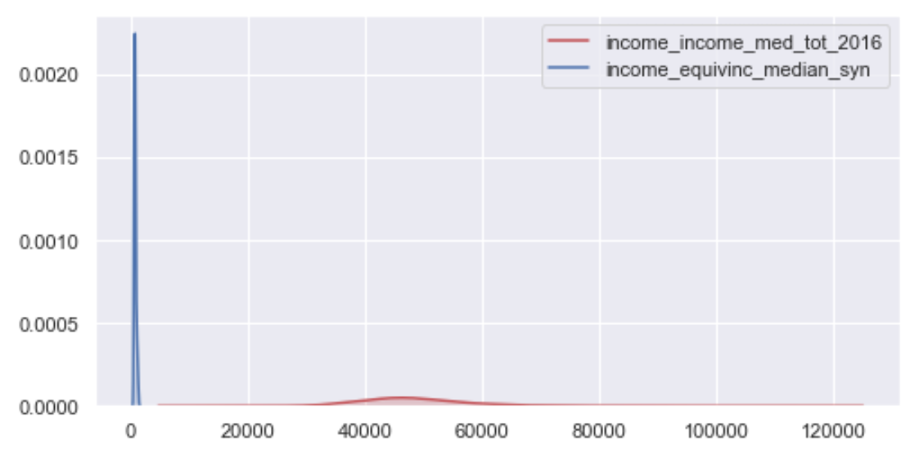
Actual Scale Features Distribution
Demography
Family
Education
Employment
Population
Finance
Language
House value
Income

Slide 16
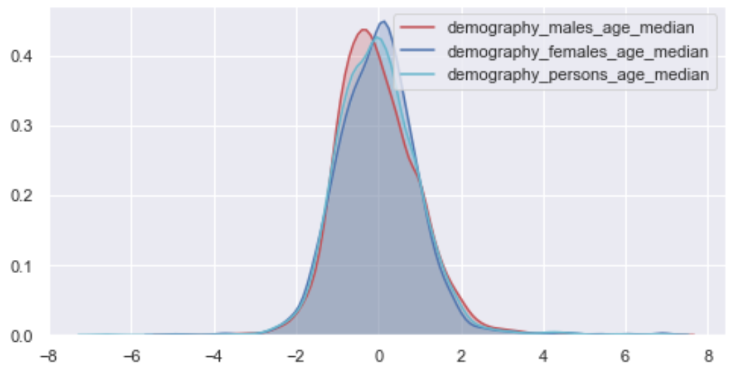
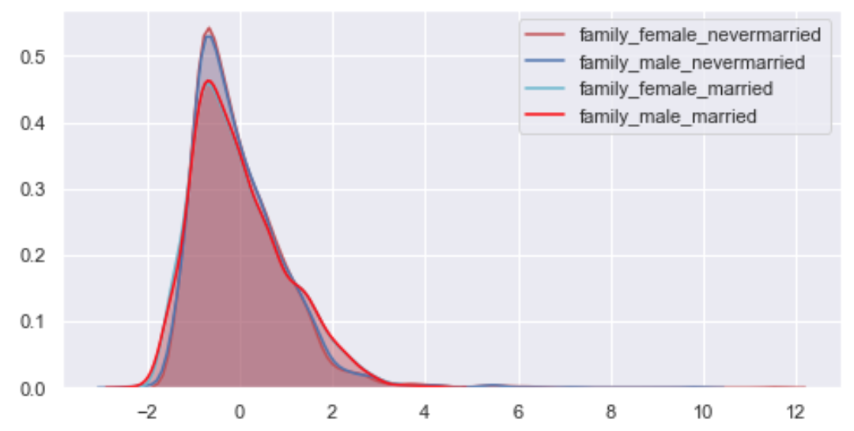
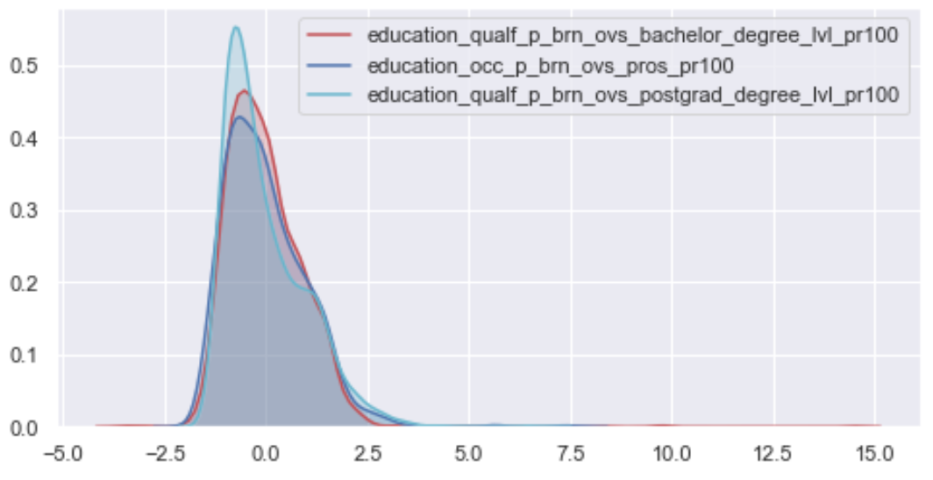
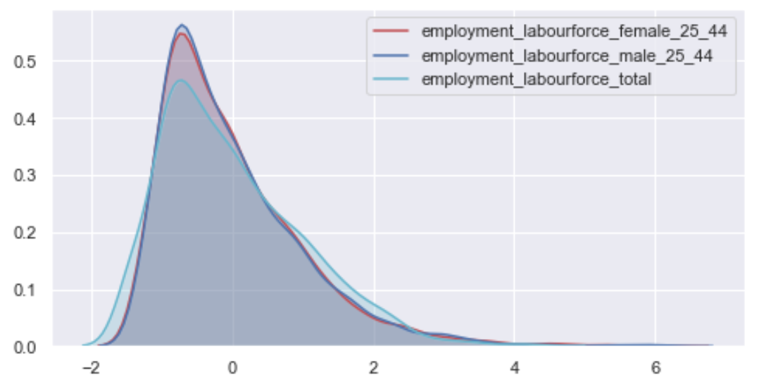
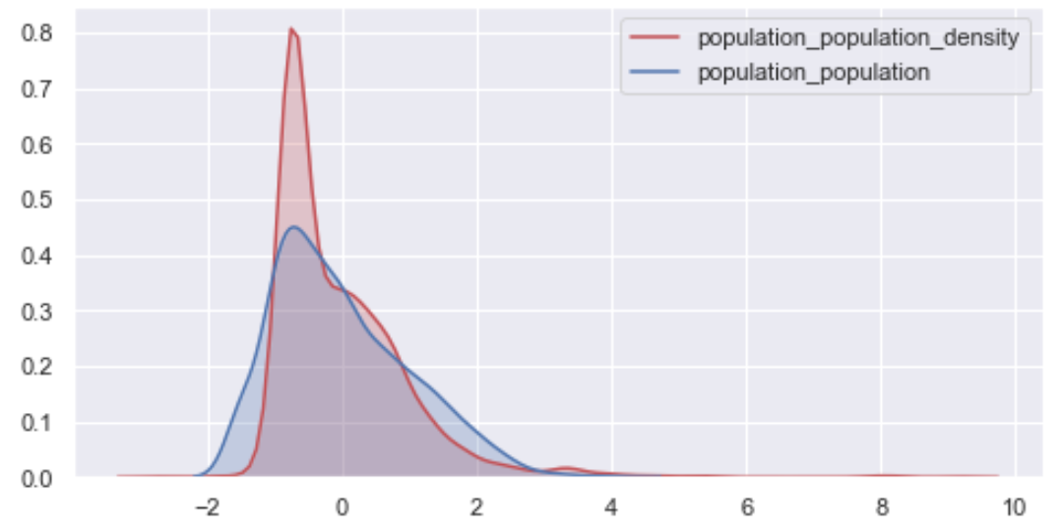
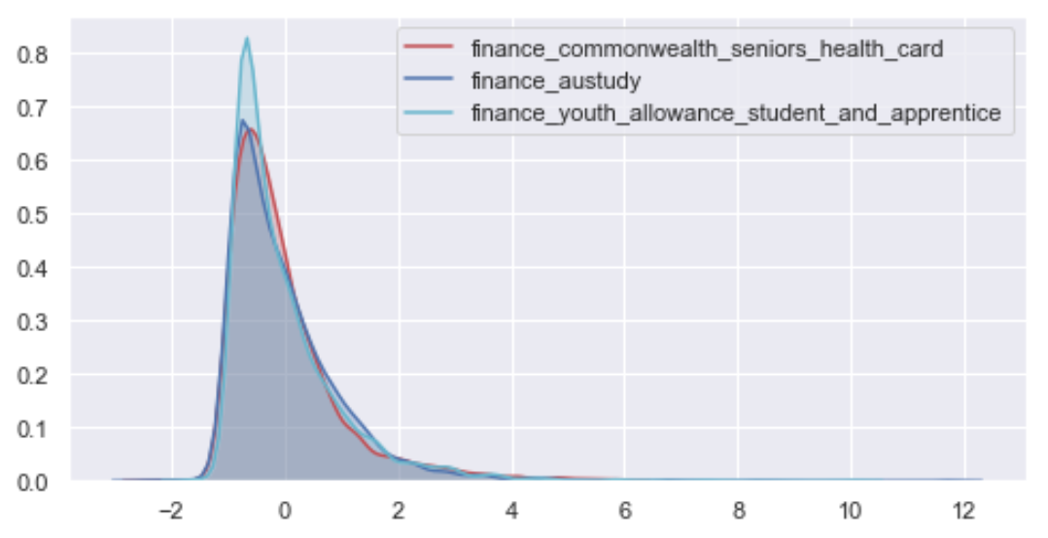
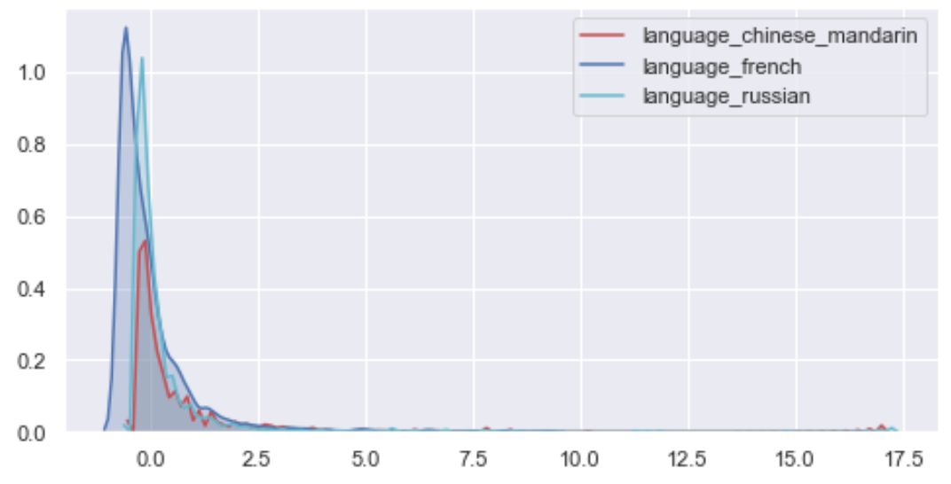
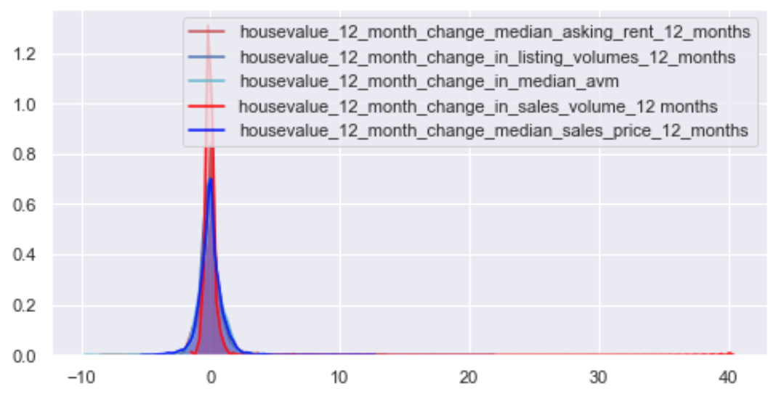
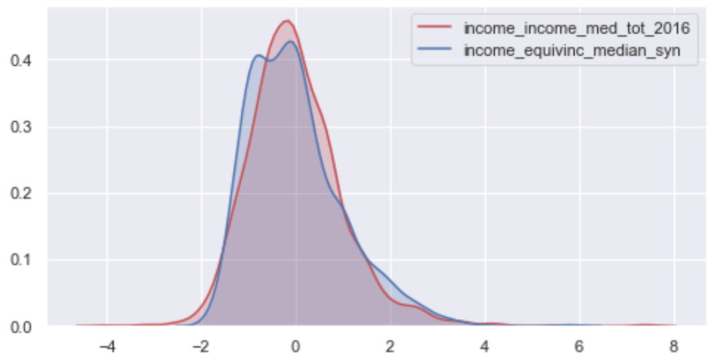
Standard Normal Scale Features Distribution
Demography
Family
Education
Employment
Population
Finance
Language
House value
Income

Slide 17
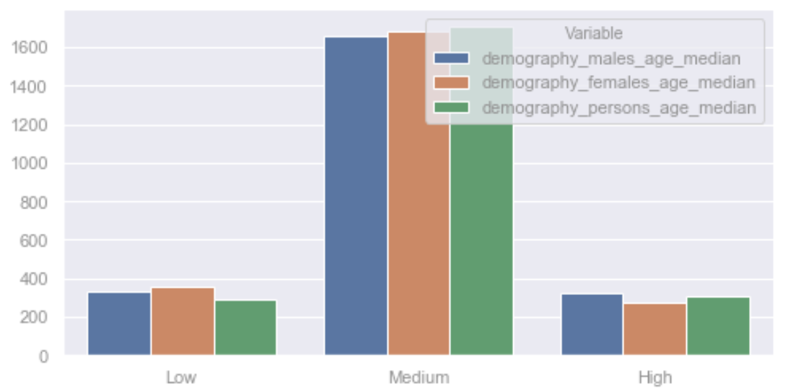
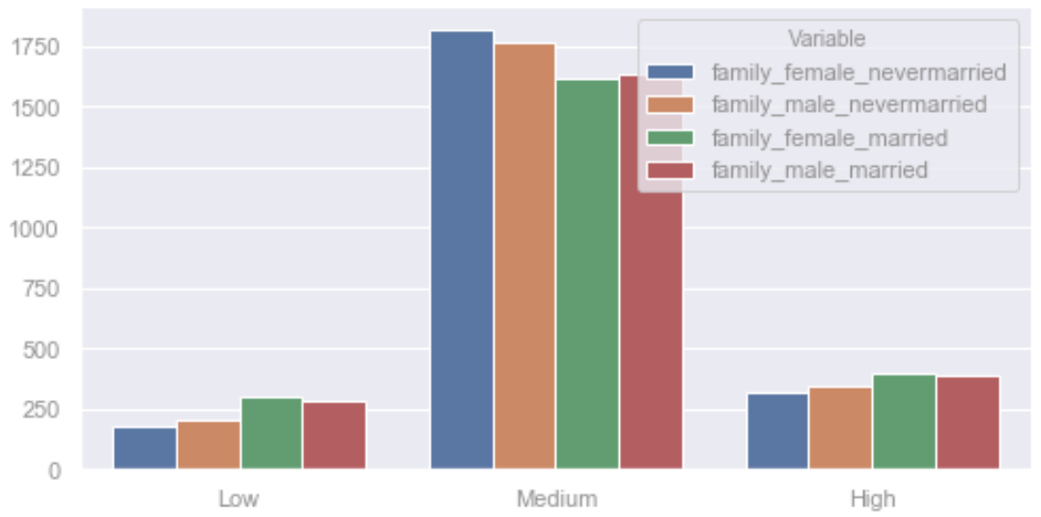
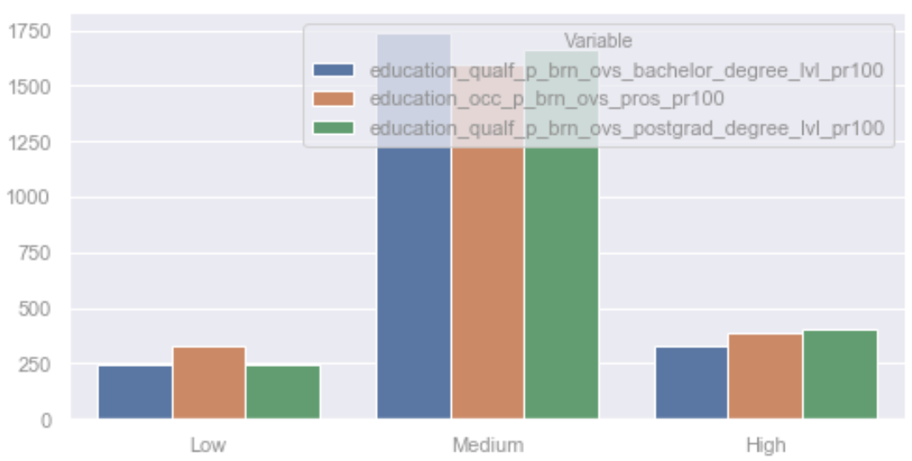
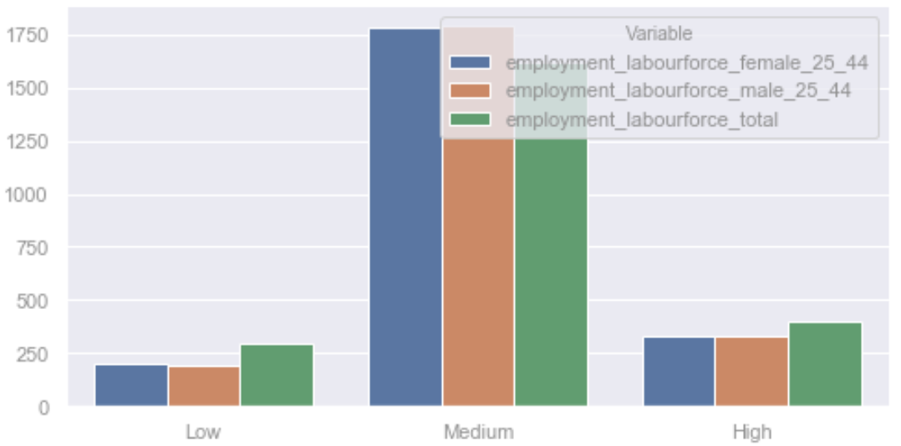
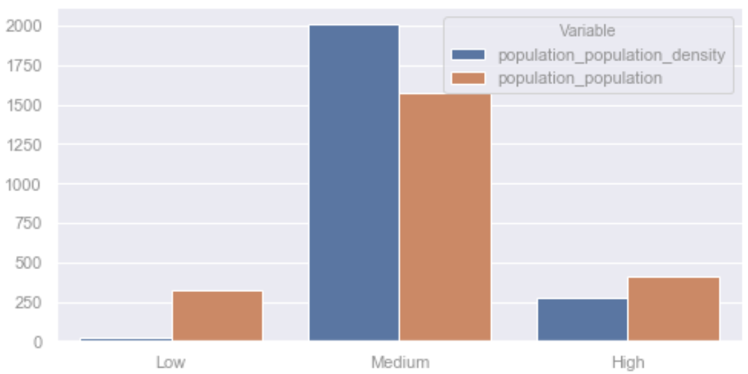
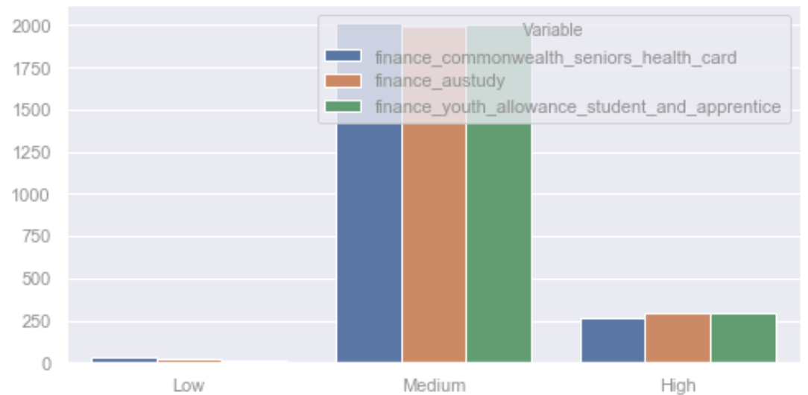



Categorical Features Distribution – Medium : 𝞵 ± 𝞂
Demography
Family
Education
Employment
Population
Finance
Language
House value
Income

Slide 18
Cluster Analysis using K-Modes with 20 Clusters on Categorical Data … [1]
Cluster 1 : 93 Areas
Cluster 4 : 69 Areas
Cluster 6 : 141 Areas
Cluster 8 : 150 Areas
Low
- Education – Bachelors
Medium
- for all other features
Low
- Demography – Age
High
- Population
- Financial ability
- Language – Spanish, Polish, Persian, Hindi, Filipino
- Indigenous people
Properties value – number of properties & listing
Employment Rate
Heath – Life Satisfaction
Families – Married, Unmarried, dependency rate
Volunteer
Medium
for all other features
Low
- Finance – have vehicle
- Language – English
- Properties value – number of properties, listing, repeated sales
Employment Rate
Heath
Families – Married, dependency rate
Medium
- for all other features
Low
Population
Finance – have vehicle
- Financial problem - no money
- Language – English
- Number of properties
Employment Rate
Heath
Families – Married, Unmarried, dependency rate
High
- Education – bachelor, post graduates
Medium
- for all other features
Cluster 2 : 489 Areas
Medium
- for all features
Cluster 3 : 92 Areas
Low
- Education – Bachelor, Post graduates
High
- Financial problem – no money
Medium
- for all other features
Cluster 7 : 27 Areas
Low
- Population
High
- Death Rate
Medium
- for all other features
Cluster 9 : 133 Areas
Low
- Properties – vacancy rate
Medium
- for all other features
Cluster 5 : 78 Areas
Low
- Female fertility rate
Medium
- for all other features

Slide 19
Cluster Analysis using K-Modes with 20 Clusters on Categorical Data … [2]
Cluster 10 : 132 Areas
Cluster 12 : 106 Areas
Cluster 14 : 121 Areas
Cluster 15 : 116 Areas
Low
Income
Health – Life satisfaction
High
- Demography - Age
Medium
- for all other features
High
- Population
- Financial ability
- Language – English
Properties value – growth
Employment Rate
Families – Married, Unmarried, dependency rate
Volunteer
Medium
for all other features
Low
- Female fertility rate
High
- Income
- Education – Bachelors, Post graduates
Employment Rate
Heath
Families – Married, dependency rate
Medium
- for all other features
Low
- Female fertility rate
High
Population
Income
Financial ability
- Language – English, French, Japanese, German, Spanish, Russian, Chinese, Polish, Dutch
- Properties value – price, listing
Employment Rate
Families – Married, Unmarried, dependency rate
- Education – bachelor, post graduates
Medium
- for all other features
Cluster 11 : 128 Areas
Low
- Demography - Age
- Properties – owner ratio
High
- Properties – renter ratio
Medium
- for all other features
Cluster 13 : 72 Areas
High
- Properties – sales price, rent demand
Medium
- for all other features

Slide 20
Cluster Analysis using K-Modes with 20 Clusters on Categorical Data … [3]
Cluster 16 : 50 Areas
Cluster 18 : 45 Areas
Cluster 20 : 83 Areas
High
Population
Financial ability
- Language – German, Dutch, English
- Properties value – growth, price, listing, repeated sales
Employment Rate
Families – Married, Unmarried, dependency rate
- Volunteer rate
Medium
- for all other features
High
- Population
- Financial ability
- Language – Spanish, Polish, Greek, Italian, Croatian, Serbian, Vietnamese
Properties – number of properties, listing
Employment Rate
Families – Married, Unmarried, dependency rate
Medium
for all other features
High
- Properties value – growth, price, listing
Medium
- for all other features
Findings
Most of the cluster properties are logically related, such as high income, financial ability, properties value, and education
Some clusters only have negative characteristics, such as high death rate, low life satisfaction
Some clusters do not have meaningful characteristics, such as low female fertility rate
The combination of features is not completely captured in each cluster, for example what if users look for location with high population, income, financial ability, educated people, families, young age, life satisfaction, properties values and low death rate
Cluster 17 : 14 Areas
Cluster 19 : 171 Areas
Low
- Death rate
High
- Properties – unit value
- People born overseas
Medium
- for all other features
High
- Development on track
Medium
- for all other features

Slide 21
Areas Characteristics Based on Categorical Data and Clustering Results … [1]
Sydney - Haymarket
Melbourne
Taylor
Cluster 15
Low
Income - median
Female fertility rate
Demography – young age
Properties value – growth, listing, repeated sales
Death Rate
High
Population
Financial ability
- Language – French, Japanese, German, Spanish, Russian, Chinese, Polish, Korean, Dutch, Indonesian, Thai
- Properties value – sales price
Employment Rate
Families – Married, Unmarried, dependency rate
- Volunteer rate
Businesses – heath care, arts and recreation
Development on track
- Health – Life Satisfaction
Financial problem – no money
- Migration
- Education – Bachelors, Post graduates
Medium
- for all other features
Cluster 4
Low
Income - median
Female fertility rate
Demography – young age
Properties value – number of properties, listing, repeated sales
High
Population
Financial ability
- Language – French, Japanese, German, Spanish, Russian, Chinese, Persian, Korean, Dutch, Indonesian, Thai, Hindi, English, Tamil, Filipino
- Properties value – sales price
Employment Rate
Families – Married, Unmarried, dependency rate
- Volunteer rate
Businesses – heath care, arts and recreation
Development on track
- Health – Life Satisfaction
Financial problem – no money
- Migration
- Education – Bachelors
Medium
- for all other features
Cluster 8
Low
Population
Financial ability
Language – German, English
Businesses – arts and recreation
- Properties value – listing, repeated sales
Employment Rate
Families – Married, Unmarried, dependency rate
- Volunteer rate
Demography – Young female
High
- Properties – sold, change in listing
Income
Demography – Young male
- Education – Post graduates
Medium
- for all other features

Slide 22
Areas Characteristics Based on Categorical Data and Clustering Results … [2]
Cluster 15 : High Positive Features
New South Wales
Victoria
Hurstville
Mortdale - Penshurst
South Hurstville - Blakehurst
Arncliffe - Bardwell Valley
Bexley
Rockdale - Banksia
Concord - Mortlake - Cabarita
Concord West - North Strathfield
Drummoyne - Rodd Point
Five Dock - Abbotsford
Balmain
Leichhardt - Annandale
Ashfield
Burwood - Croydon
Croydon Park - Enfield
Dulwich Hill - Lewisham
Strathfield
Chatswood (East) - Artarmon
Chatswood (West) - Lane Cove North
Lane Cove - Greenwich
Willoughby - Castle Cove - Northbridge
Normanhurst - Thornleigh - Westleigh
Gordon - Killara
Lindfield - Roseville
St Ives
Turramurra
Wahroonga (East) - Warrawee
Cremorne - Cammeray
Crows Nest - Waverton
Mosman
Neutral Bay - Kirribilli
Balgowlah - Clontarf - Seaforth
Manly - Fairlight
Warriewood - Mona Vale
Dee Why - North Curl Curl
Frenchs Forest - Belrose
Freshwater - Brookvale
Manly Vale - Allambie Heights
Narrabeen - Collaroy
Homebush Bay - Silverwater
Carlingford
Ermington - Rydalmere
Oatlands - Dundas Valley
Epping - North Epping
Pennant Hills - Cheltenham
Eastwood - Denistone
Macquarie Park - Marsfield
West Ryde - Meadowbank
Ryde
Miranda - Yowie Bay
Cronulla - Kurnell - Bundeena
Sutherland - Kirrawee
Brunswick
Northcote
Thornbury
Essendon - Aberfeldie
Carlton
North Melbourne
Southbank
Albert Park
Elwood
Port Melbourne
St Kilda
St Kilda East
Prahran - Windsor
South Yarra - East
Richmond (Vic.)
Balwyn North
Camberwell
Hawthorn
Hawthorn East
Kew
Blackburn
Box Hill
Box Hill North
Brighton (Vic.)
Hampton
Bentleigh - McKinnon
Carnegie
Caulfield - North
Caulfield - South
Mordialloc - Parkdale
Malvern - Glen Iris
Malvern East
Ashwood - Chadstone
Glen Waverley - East
Glen Waverley - West
Mount Waverley - South
Baulkham Hills (East)
Baulkham Hills (West) - Bella Vista
Cherrybrook
Kellyville
Mascot - Eastlakes
Marrickville
Petersham - Stanmore
Erskineville - Alexandria
Glebe - Forest Lodge
Newtown - Camperdown - Darlington
Potts Point - Woolloomooloo
Pyrmont - Ultimo
Redfern - Chippendale
Surry Hills
Sydney - Haymarket - The Rocks
Waterloo - Beaconsfield
Bondi - Tamarama - Bronte
Bondi Beach - North Bondi
Bondi Junction - Waverly
Double Bay - Bellevue Hill
Paddington - Moore Park
Coogee - Clovelly
Malabar - La Perouse - Chifley
Randwick - North
Kingsgrove (North) - Earlwood
Queensland
Surfers Paradise
Western Australia
Nedlands - Dalkeith - Crawley
Wembley - West Leederville - Glendalough

Slide 23
Areas Characteristics Based on Categorical Data and Clustering Results … [3]
Cluster 4 : High Positive Features
Findings
New South Wales
Victoria
Queensland
Blacktown (East) - Kings Park
Blacktown (North) - Marayong
Doonside - Woodcroft
Seven Hills - Toongabbie
Parklea - Kellyville Ridge
Quakers Hill
Hassall Grove - Plumpton
Lethbridge Park - Tregear
Mount Druitt - Whalan
Rooty Hill - Minchinbury
Canterbury (South) - Campsie
Campbelltown - Woodbine
Claymore - Eagle Vale - Raby
Macquarie Fields - Glenfield
Minto - St Andrews
Rosemeadow - Glen Alpine
Kingswood - Werrington
Lidcombe
Granville - Clyde
Guildford - South Granville
Merrylands - Holroyd
North Parramatta
Northmead
Parramatta - Rosehill
Toongabbie - Constitution Hill
Holsworthy - Wattle Grove
Liverpool
Prestons - Edmondson Park
Melbourne
Reservoir - East
Reservoir - West
Pascoe Vale
Glenroy
Roxburgh Park - Somerton
Berwick - South
Cranbourne North
Hampton Park - Lynbrook
Dandenong
Noble Park - West
Clayton
Deer Park - Derrimut
Footscray
Hillside
Taylors Hill
Caroline Springs
Hoppers Crossing - South
Tarneit
Truganina
Wyndham Vale
Point Cook - North
Werribee - East
Calamvale - Stretton
Forest Lake - Doolandella
Cluster analysis on numeric data tend to put Sydney – Haymarket, Melbourne and Taylor as independent cluster. Some algorithms return Sydney – Haymarket and Melbourne in one cluster.
Cluster analysis on categorical data found that Sydney – Haymarket and Melbourne are part of clusters with most of the positive features are high. In contrast, Taylor have a reverse characteristics and it belongs to cluster with many low positive features.
This segmentation can be the early choice for users before they choose their priority features. The rank of areas can be measured using the rank order based on numeric features selected by users as the priority.
The 2 clusters with high positive features only contain areas from state New South Wales, Victoria, Queensland, South Australia and Western Australia with most cities are from New South Wales and Victoria. Do clustering based on State will give more information on areas characteristics relative to its neighbours.
South Australia
Enfield - Blair Athol
Windsor Gardens
Plympton
Western Australia
Perth City
Beechboro
Ellenbrook
Balga - Mirrabooka
Nollamara - Westminster
Madeley - Darch - Landsdale
Forrestdale - Harrisdale - Piara Waters
Rivervale - Kewdale - Cloverdale
Bentley - Wilson - St James
Cannington - Queens Park
Beckenham - Kenwick - Langford
Canning Vale - East
Huntingdale - Southern River

Slide 24
Analysis on

Slide 25


Tweet Frequency Based on SA2 areas and State
Top 20 SA2 Areas
State of the SA2 Areas

Slide 26




Tweet Frequency Based on Twitter Users and SA2 Areas
Distribution number of tweets per user per sa2 areas
Distribution number of unique sa2 areas per user
outliers
outliers
Some Twitter users posted tweets from a considerable number of SA2 areas. The areas visited by the users are assumed to be easily accessible.
Some Twitter users posted a considerable number of tweets from the same areas. Thus, there are some SA2 areas have more tweets than the other.

Slide 27
Association Rule Mining Through Apriori Algorithm on Tweet Location – Based on State
South Australia, New South Wales, Northern Territory, Western Australia
Support : 0.0014
South Australia, New South Wales, Northern Territory → Western Australia
-----------------------------------------------------------------------------------------
Confidence : 0.739
Lift : 7.177
New South Wales, Northern Territory, Western Australia → South Australia
-----------------------------------------------------------------------------------------
Confidence : 0.772
Lift : 10.933
South Australia, Queensland, Northern Territory, Western Australia
Support : 0.0014
South Australia, Queensland, Northern Territory → Western Australia
-----------------------------------------------------------------------------------------
Confidence : 0.772
Lift : 7.503
Queensland, Northern Territory, Western Australia → South Australia
-----------------------------------------------------------------------------------------
Confidence : 0.708
Lift : 10.022
Western Australia, South Australia, Northern Territory, Victoria
Support : 0.0014
South Australia, Northern Territory, Victoria → Western Australia
-----------------------------------------------------------------------------------------
Confidence : 0.772
Lift : 7.503
Western Australia, Northern Territory, Victoria → South Australia
-----------------------------------------------------------------------------------------
Confidence : 0.772
Lift : 10.933
Western Australia, South Australia, New South Wales, Victoria
Support : 0.0026
Western Australia, New South Wales, Victoria → South Australia
-----------------------------------------------------------------------------------------
Confidence : 0.673
Lift : 9.535
Western Australia, South Australia, Queensland, Victoria
Support : 0.0023
Western Australia, Queensland, Victoria → South Australia
-----------------------------------------------------------------------------------------
Confidence : 0.651
Lift : 9.213

Slide 28
Twitter Users Frequency Based on Tweet Location
Number of users post tweets from 2 SA2 Areas
Number of users post tweets from 3 SA2 Areas

Slide 29
Association Rule Mining Through Apriori Algorithm on Tweet Location – Based on SA2 Areas … [1]
Gawler – South → Adelaide
Support: 0.0027
Confidence: 0.7142
Lift: 20.601
Port Adelaide -> Adelaide
Support: 0.0013
Confidence: 0.7142
Lift: 20.601
Richmond (SA) -> Adelaide
Support: 0.0016
Confidence: 0.6666
Lift: 19.228
Toorak Gardens -> Adelaide
Support: 0.0010
Confidence: 0.6666
Lift: 19.228
Unley – Parkside -> Adelaide
Support: 0.0019
Confidence: 0.7777
Lift: 22.433
Brisbane City → Brisbane City
Support: 0.0010
Confidence: 0.6666
Lift: 10.090
Balgownie - Fairy Meadow -> Wollongong - East
Support: 0.0013
Confidence: 1
Lift: 192.789
Bathurst -> Bathurst Region
Support: 0.0032
Confidence: 1
Lift: 281.769
Bathurst Region -> Bathurst
Support: 0.0032
Confidence: 0.923
Lift: 281.769
Benalla -> Benalla Region
Support: 0.0010
Confidence: 1
Lift: 601.5
Benalla Region → Benalla
Support: 0.0010
Confidence: 0.6666
Lift: 601.49
Margate - Woody Point -> Brisbane City
Support: 0.0010
Confidence: 0.666
Lift: 10.090
Spring Hill -> Brisbane City
Support: 0.0010
Confidence: 666
Lift: 10.090
Broken Hill -> Far West
Support: 0.0021
Confidence: 1
Lift: 457.87
Far West -> Broken Hill
Support: 0.0021
Confidence: 1
Lift: 457.87
Association Rule Mining based on Twitter Data add more information of relationship between areas. The pattern shared between Twitter users who most likely moving in certain areas can be used in Recommendation system. Users can predefined which areas they have been living in and app can suggest which areas they might want to stay next based on their preferences and this pattern.

Slide 30
Association Rule Mining Through Apriori Algorithm on Tweet Location – Based on SA2 Areas
Associated Areas Sorted by Support

